Slide 1
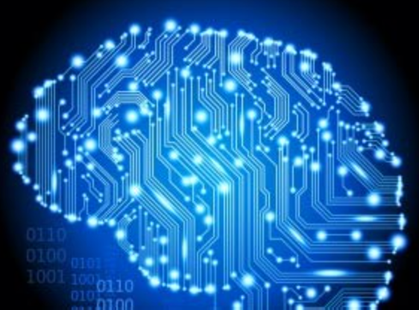
Knowledge 4

Slide 2
First-Order Logic: Deduction

Slide 3
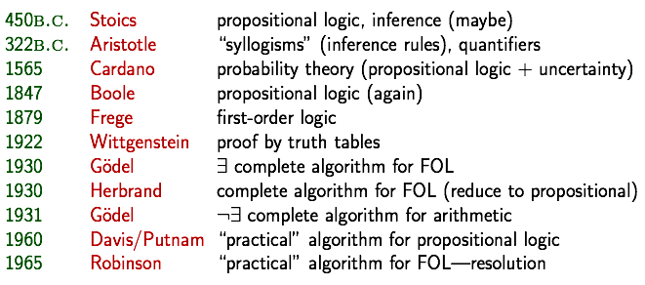
A brief history of reasoning

Slide 4
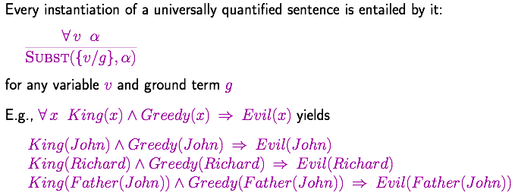
Universal Instantiation (UI)

Slide 5
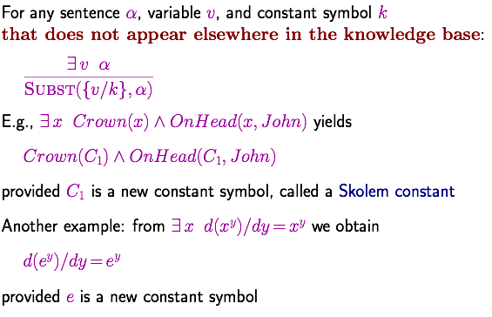
Existential Instantiation (EI)

Slide 6
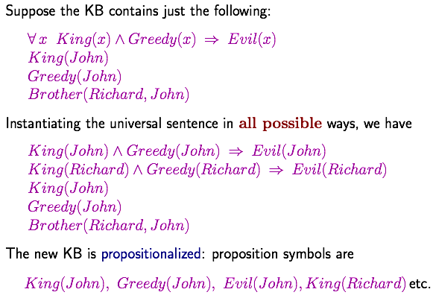
Reduction to propositional inference

Slide 7
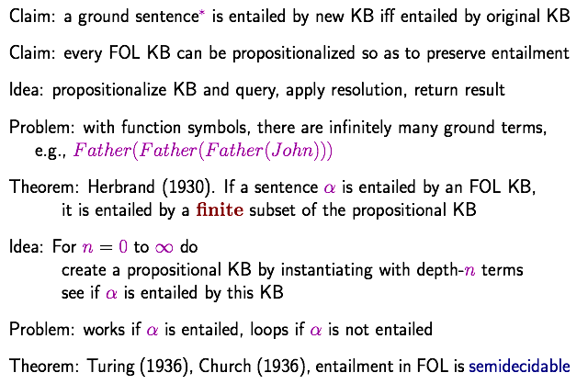
Reduction to propositional inference
Inferentially equivalent
Notes:
Inferentially equivalent: EI带来的问题，需要对EI引入的变元进行解释

Slide 8
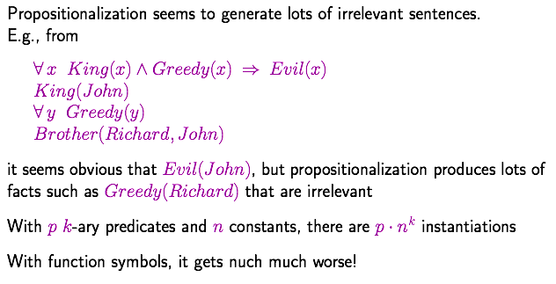
Problems with propositionalization
much

Slide 9
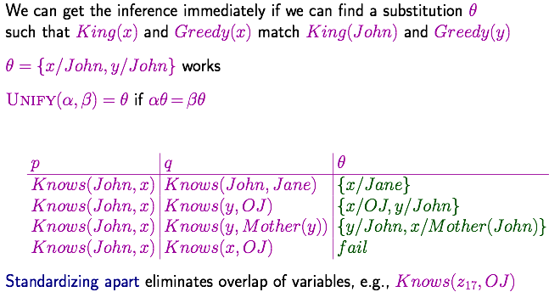
Unification

Slide 10
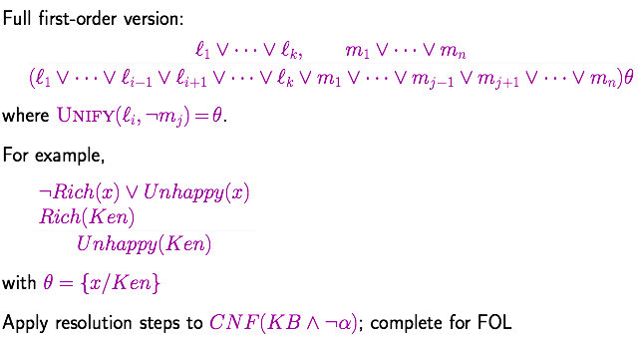
Resolution: brief summary

Slide 11
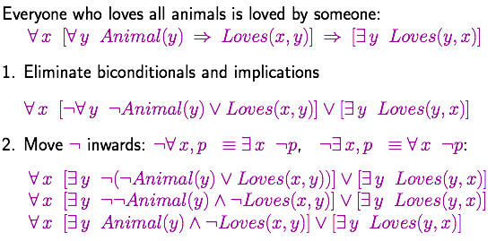
Conversion to CNF

Slide 12
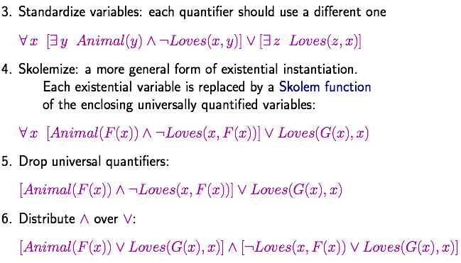
Conversion to CNF

Slide 13
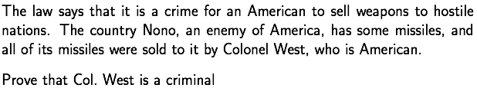
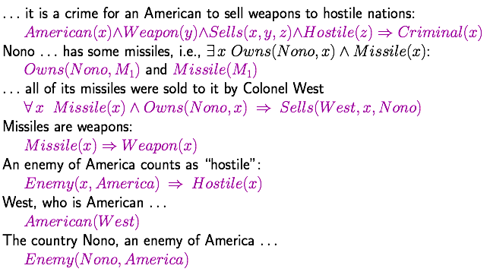
Example knowledge base

Slide 14
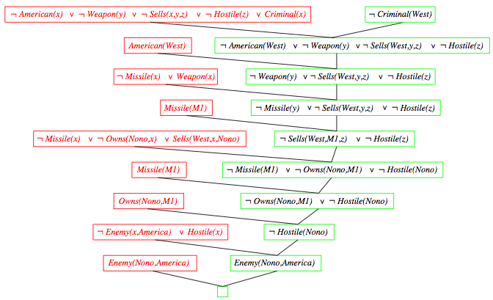
Resolution proof
¬

Slide 15
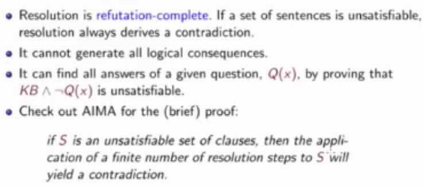
Completeness of FOL resolution
反驳

Slide 16
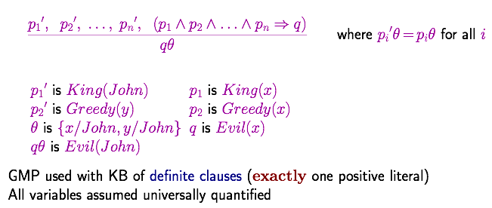
Generalized Modus Ponens (GMP)
（前件推理）

Slide 17
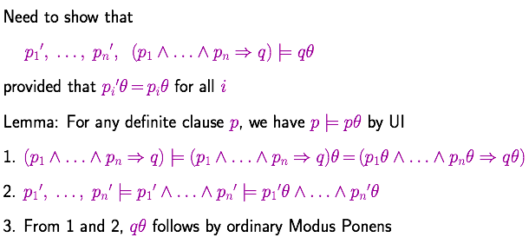
Soundness of GMP
the soundness of ordinary Modus Ponens

Slide 18
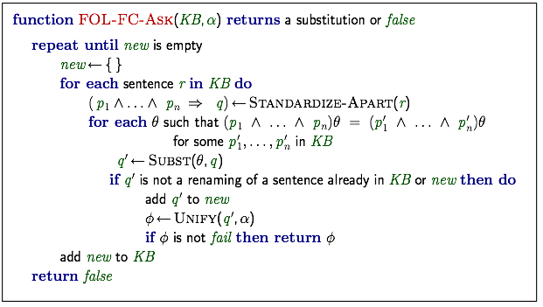
Forward chaining algorithm

Slide 19
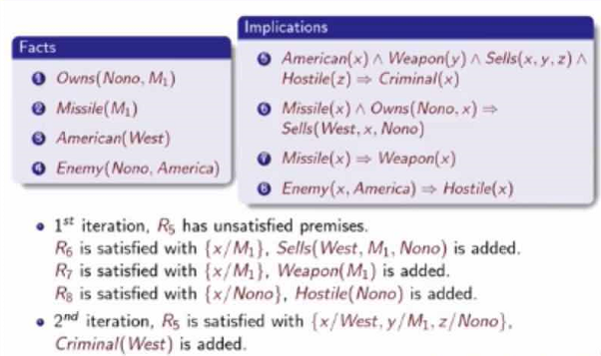
Forward chaining proof

Slide 20
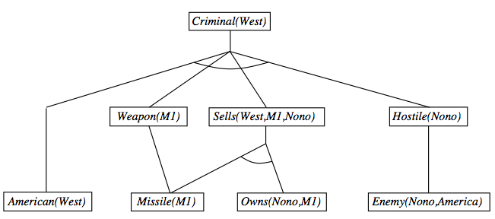
Forward chaining proof

Slide 21
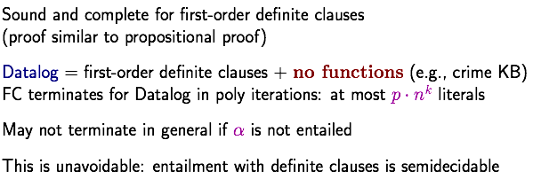
Properties of forward chaining
with functions

Slide 22
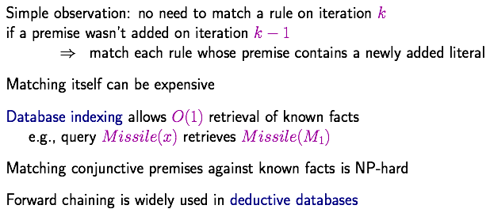
Efficiency of forward chaining

Slide 23
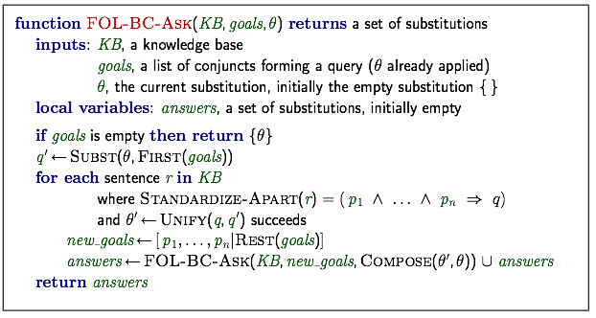
Backward chaining algorithm

Slide 24
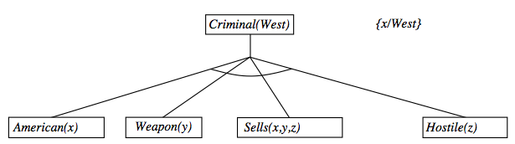
Backward chaining example

Slide 25
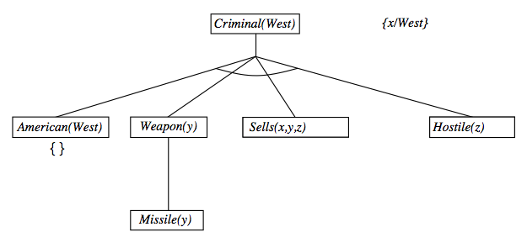
Backward chaining example

Slide 26
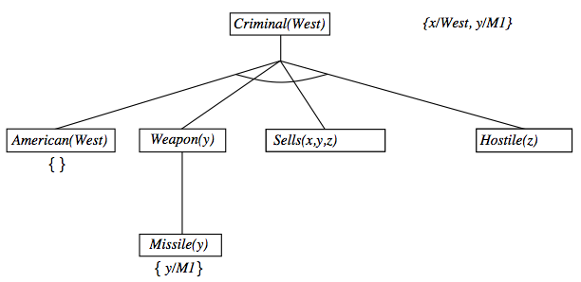
Backward chaining example

Slide 27
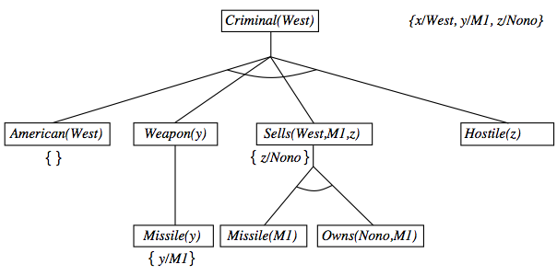
Backward chaining example

Slide 28
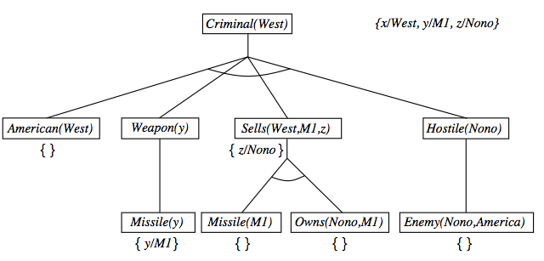
Backward chaining example

Slide 29
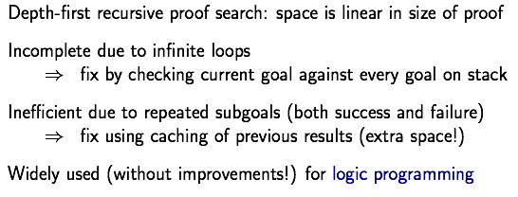
Properties of backward chaining
AND-OR search: AND for all premises; OR since the goal query can be proved by any rules.

Slide 30
Logic Programming: Prolog

Slide 31
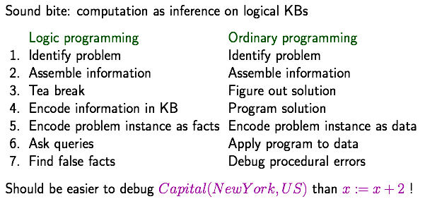
Logic programming

Slide 32
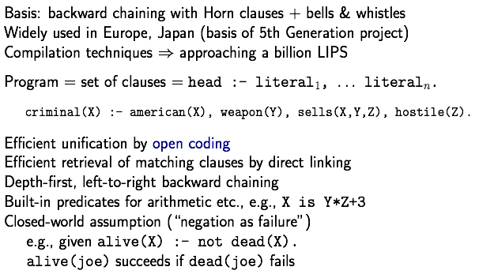
Prolog systems
如果

Slide 33
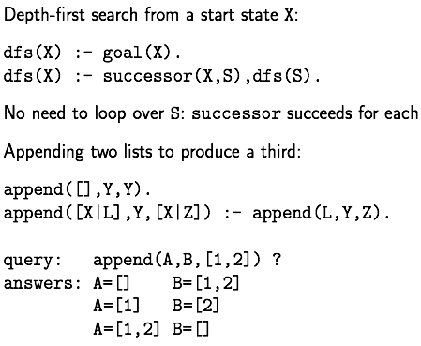
Prolog examples
第二个input放到第一个的右面

Slide 34
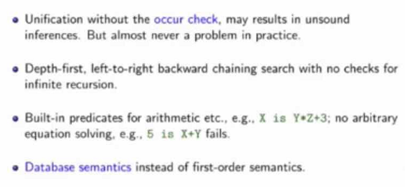

Prolog systems

Slide 35
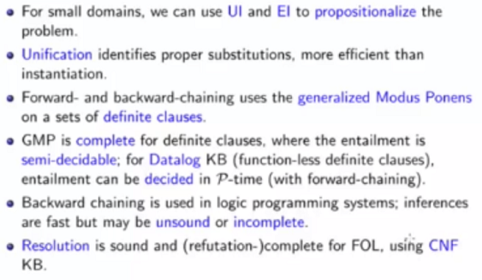
Summary

Slide 36
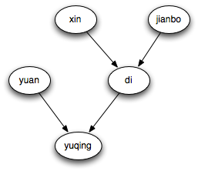
Prolog example
Homework
member(1,[1,2,3,4,5])
member(3,[1,2,3,4,5]) 要求：给出一个集合，列出其所有元素
subset([2,4],[1,2,3,4,5]) 要求：给出一个集合，列出其所有子集
query: grandfather(X,yuqing)?
male(di).
male(jianbo).
female(xin).
female(yuan).
female(yuqing).
father(jianbo,di).
father(di,yuqing).
mother(xin,di).
mother(yuan,yuqing).
grandfather(X,Y):-father(X,Z),father(Z,Y).
grandmother(X,Y):-mother(X,Z),father(Z,Y).
daughter(X,Y):-father(X,Y),female(Y).

Slide 37
选做作业
构造一个一阶谓词逻辑表达知识库（如：数学公理），并通过归结原理，推出一个有意思的结论。
直接email：luop@ict.ac.cn
出色的答案，期末成绩加一分。

